Slide 1


THE ROOM
Search for the room for your perfect event!
Carolain Restituto 0124002400
Domenico Saverio Spaltro 0124002414
Università degli studi di Napoli Parthenope.

Slide 2
WHAT IS ‘’THE ROOM’’?
THE ROOM IS A PWA THAT HAS ONLY ONE TASK: MAKE YOUR PARTY MEMORABLE!
HOW? IT’S SIMPLE…
With our web app you can easily organize your party: The user through a series of filters (number of people, price, number of tables, etc.) will find the place most akin to the event he wants to organize and can book it directly from the app!

Slide 3





TECHNOLOGIES USED
HTML for the content.
CSS for the representation style
PAYPAL for the payment system
JAVASCRIPT for the implementation
of the various functions

Slide 4
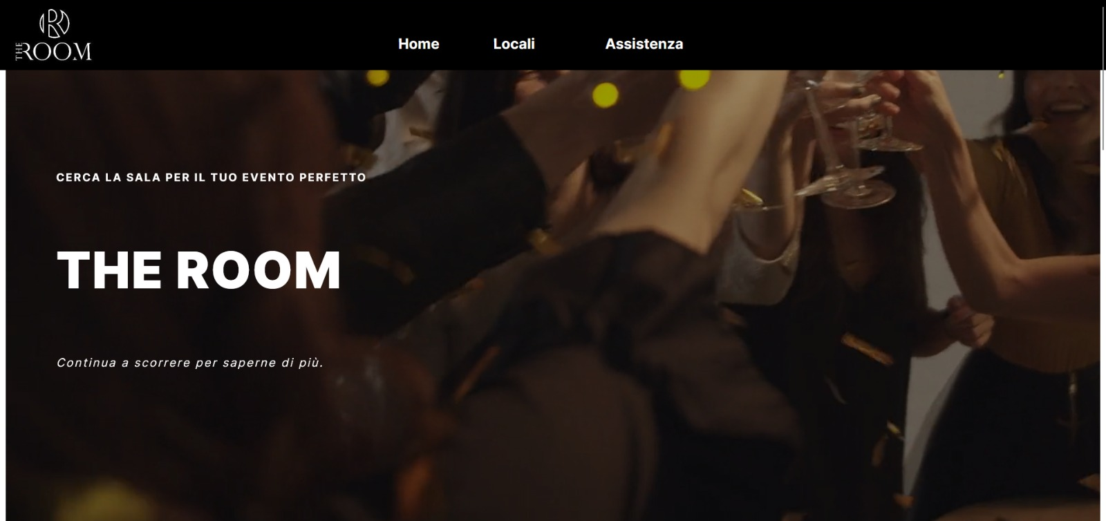
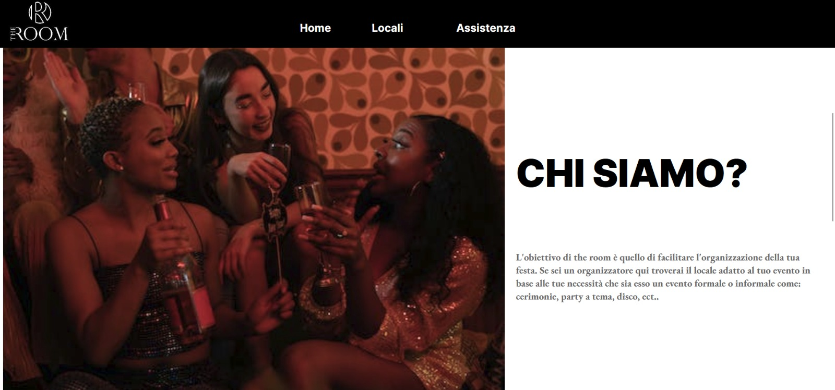
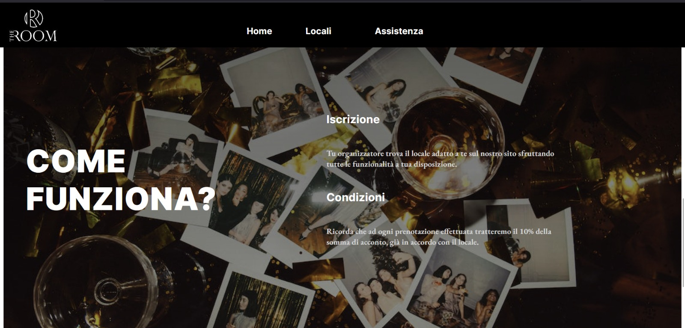
HOME
When the PWA is opened a home page is shown
With the name of the PWA and a video played in the background.
Scrolling we’ll find some info about us.
At the end of the home page we’ll find some more info but this time about the utility of our PWA

Slide 5
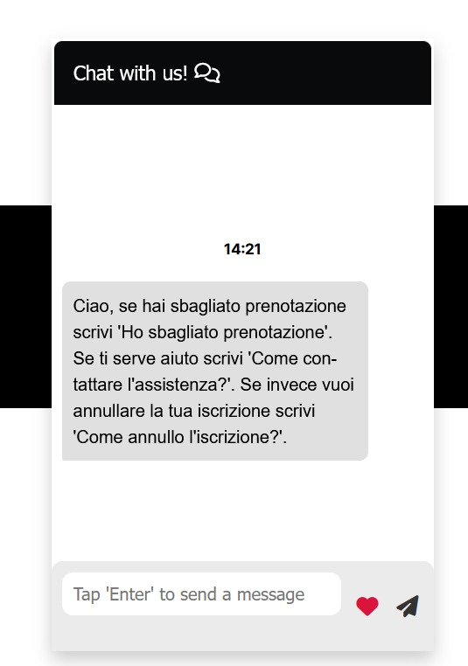
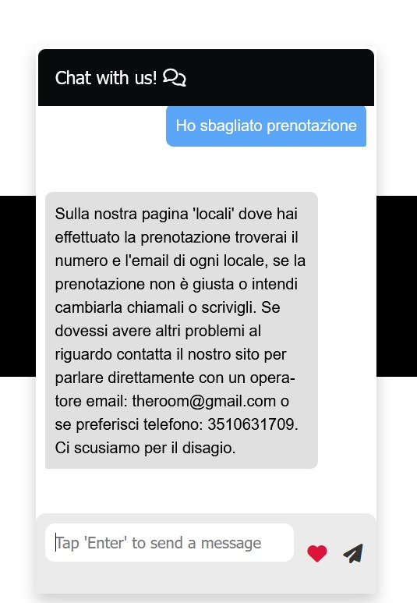
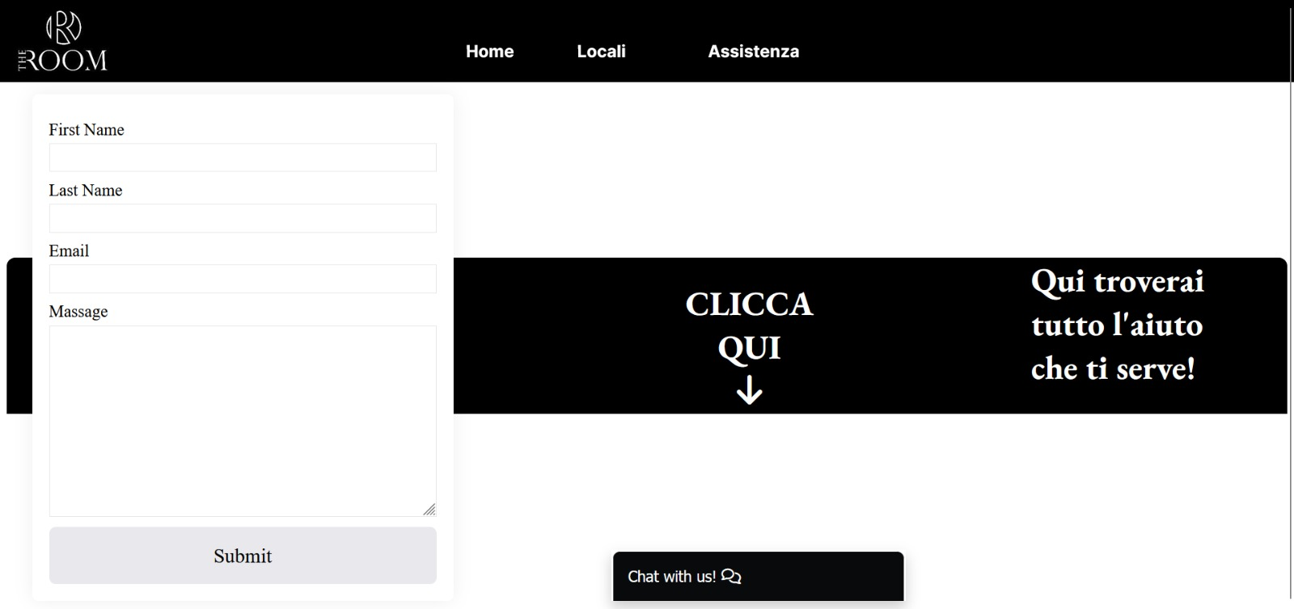
SUPPORT
In the support section you’ll find a simple form to send a message to our support team and also a chat with a bot that will help you every time you need!
As you can see our bot will answer your questions and it will give to you a solution, within the limits of any inanimate being.

Slide 6
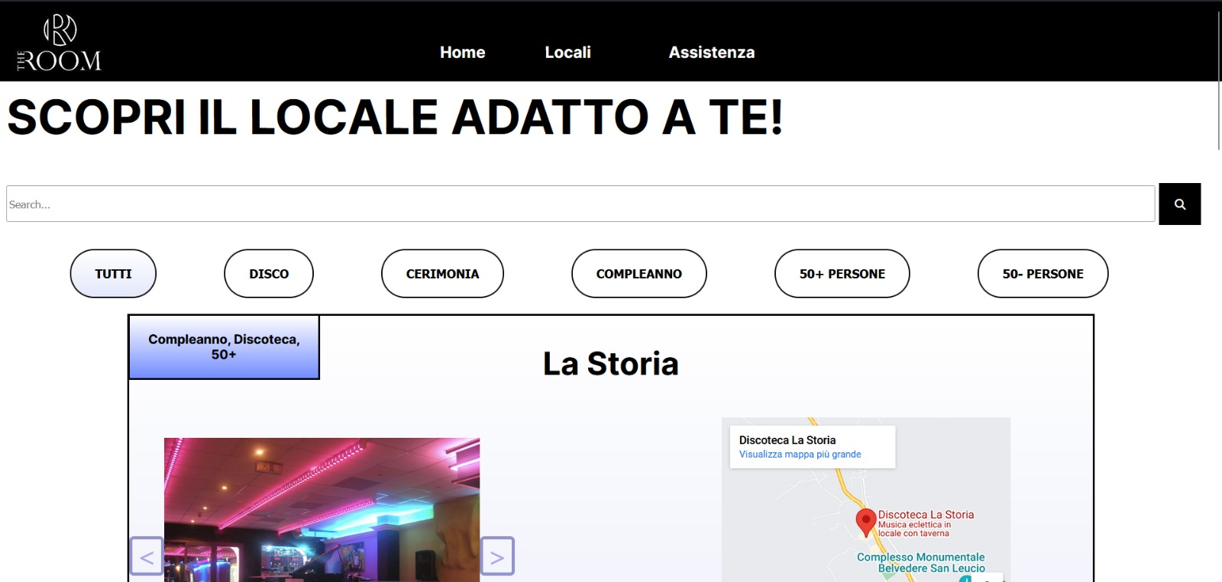
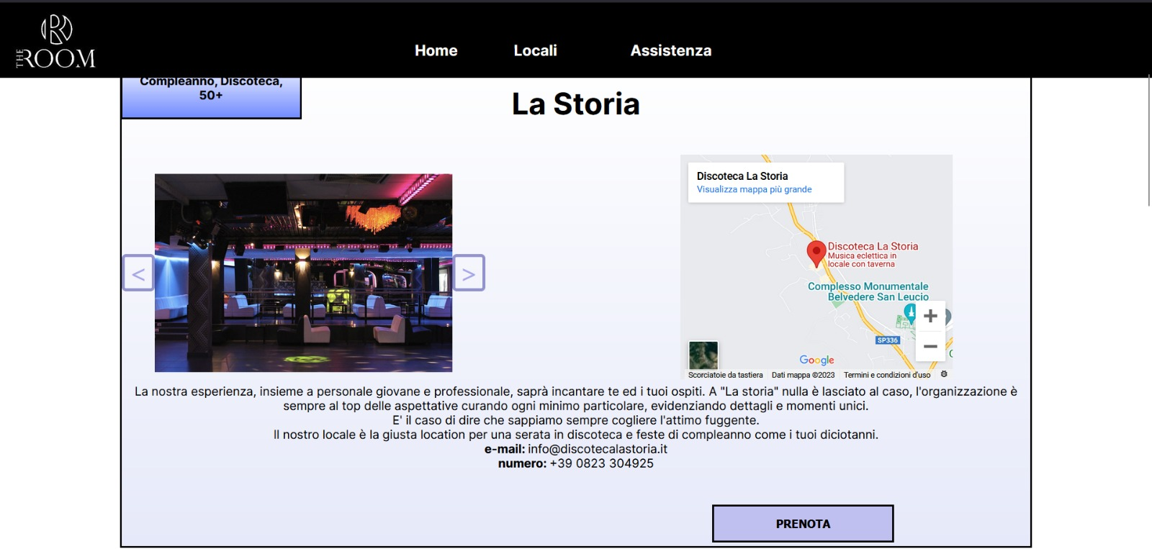
ROOMS
In the locals section we can find the list of rooms that are available on our portal.
You can also use the search bar to find a specific room or use the filters to find the right room for your event!
For every room you’ll find a description and some sliding photos.
you will find a small map with a pin for the location of the room and of course e-mail and phone number of the owner.

Slide 7
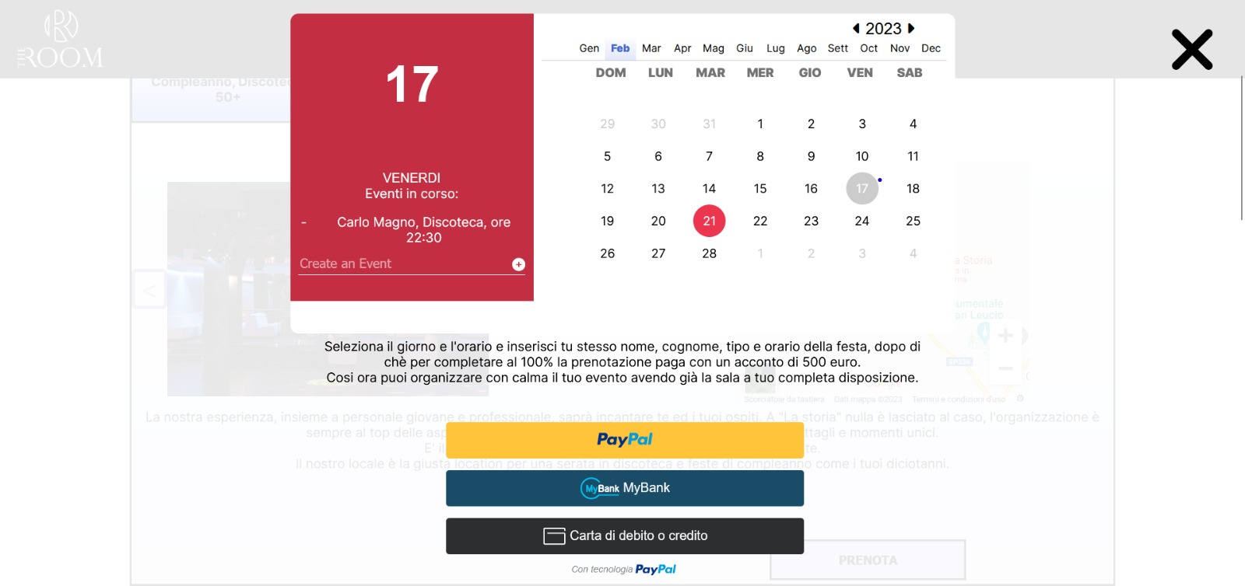
HOW TO MAKE A BOOKING (1/3)
To make a booking you have first to choose the room for your event and then click on the book button.
Than it will appear this window where you can easily choose the day of the event and add name, surname, time and tipe of the event.

Slide 8
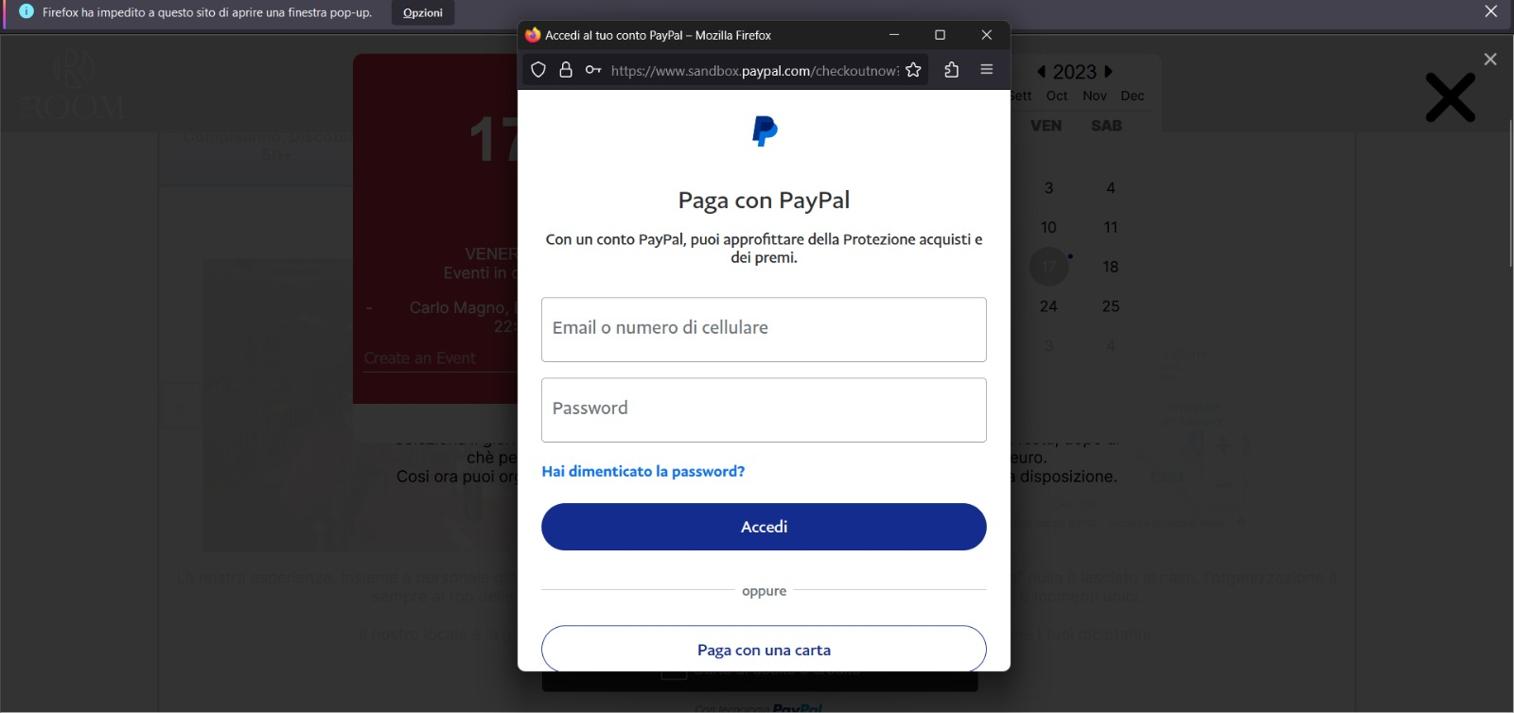
HOW TO MAKE A BOOKING (2/3)
After this few steps you have to choose a payment method, for example PayPal. You have to login with your PayPal account.

Slide 9
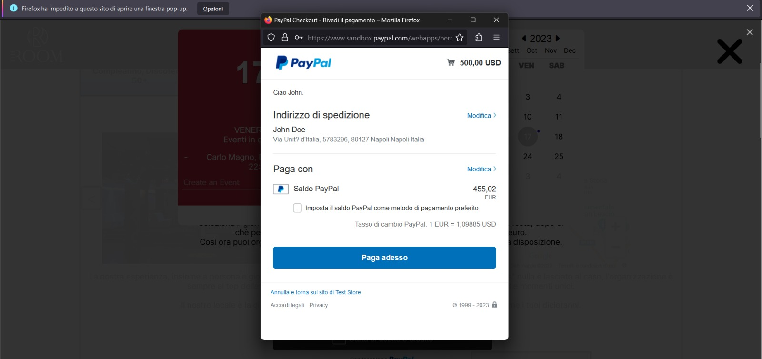
HOW TO MAKE A BOOKING (3/3)
After the login you can pay your booking (10% of the payment is held by us) and now your event is ready to be set up and start!

